Slide 1


Real-Time Object Detection System
Enhancing Efficiency and Accuracy with YOLOv5
SUPERVISOR: ASST. PROF. ANCHAL SAGAR
RAUT SHUBHAM
AMAN PAL
VIVEK KUMAR GUPTA
BONTHA CHAKRI
12222170
12221792
12215379
12204429

Slide 2
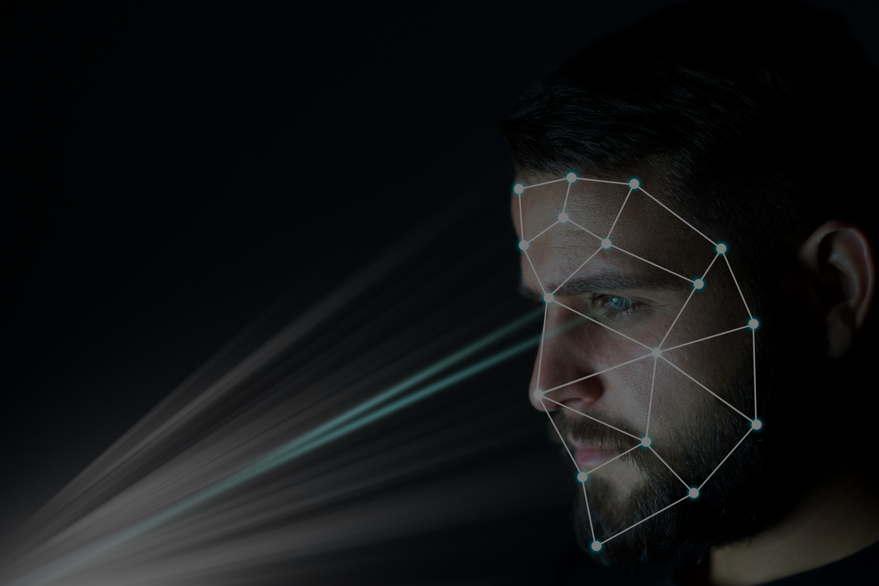
AGENDA
01
02
INTRODUCTION
MODULE LIST
03
04
MODULE
EXPLANATION
THANKS

Slide 3
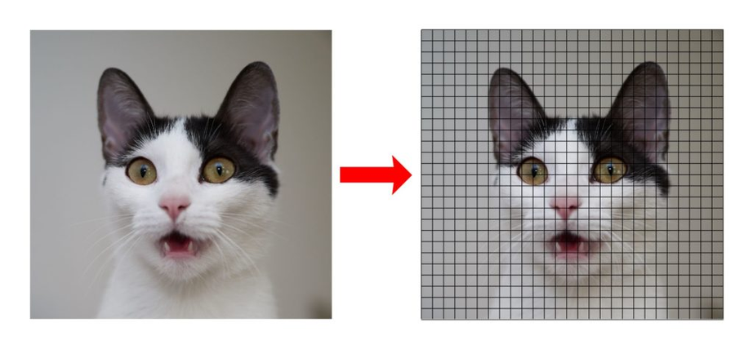
INTRODUCTION
How Does it Work?
01
02
03
Real-time object detection is a computer vision technique that involves detecting and locating objects in video streams or live camera feeds in real-time.
It combines object recognition algorithms with the ability to process video data as it is being captured, without any significant delay.
The system analyzes each frame of the video stream, identifies the presence of objects, and draws bounding boxes around them, often with labels indicating the object class.

Slide 4
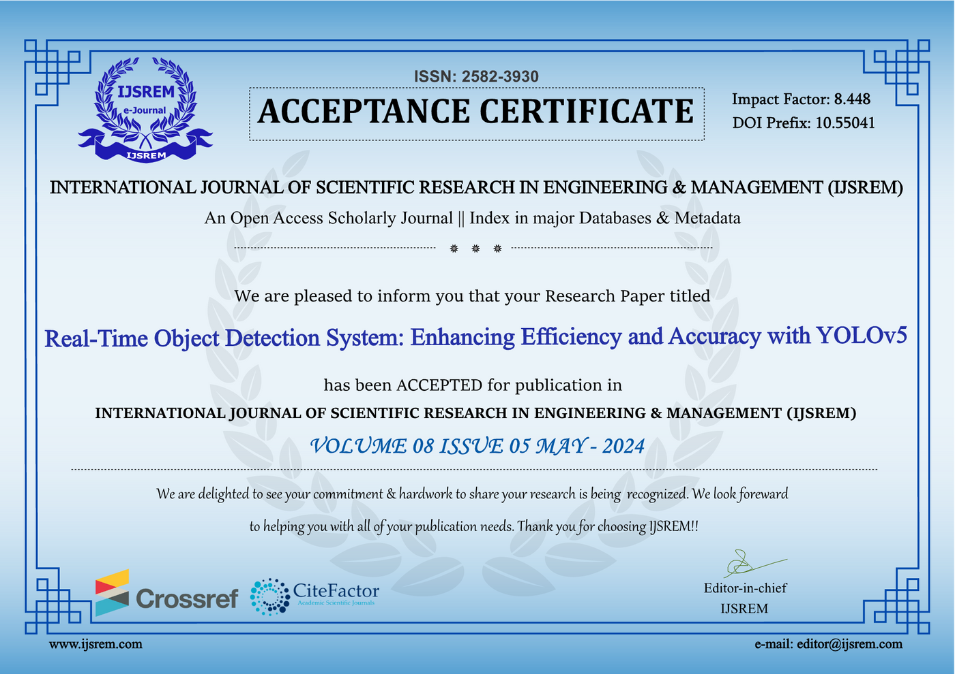
Acceptance Certificate

Slide 5
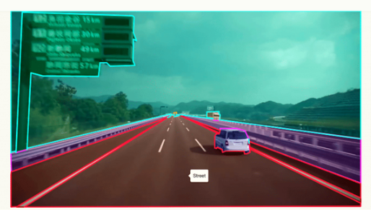
USE CASES
01
02
03
04
Security and Surveillance: Real-time object detection can enhance security systems by alerting authorities to potential threats or suspicious activity as soon as it occurs.
Autonomous Vehicles: Self-driving cars rely on real-time object detection to identify obstacles, pedestrians, and other vehicles on the road for safe navigation.
Retail Analytics: In retail settings, real-time object detection can be used for customer tracking, inventory management, and analyzing customer behavior.
Industrial Automation: Real-time object detection can be used in manufacturing processes for quality control, defect detection, and robot guidance.

Slide 6
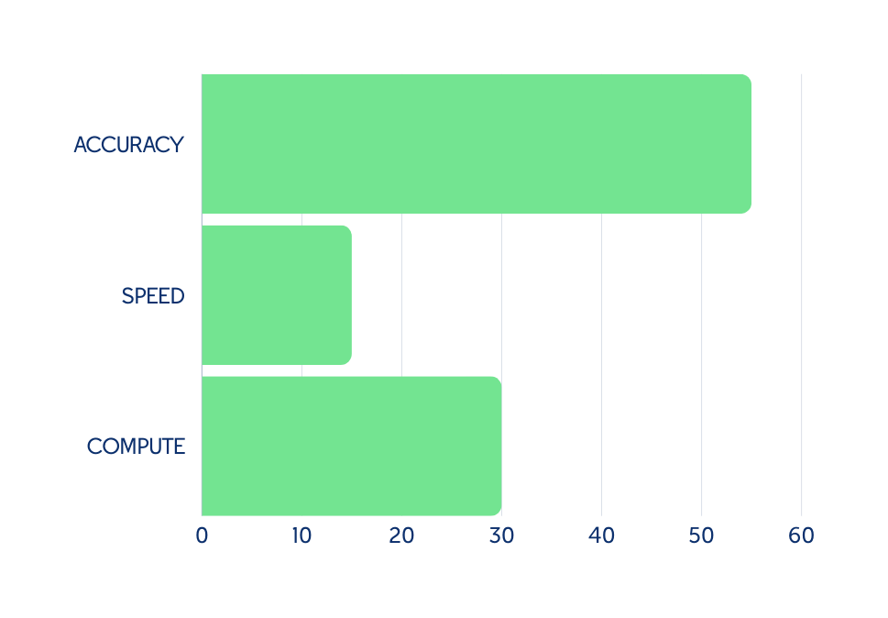
Challenges
GOAL IS TO MAKE THE GRAPHS MORE STABLE WITH MORE FINE TUNING OF DATA AND INPUTS
01
Accuracy: Achieving high accuracy in object detection is crucial, as false positives or missed detections can have severe consequences in many applications.
02
03
Speed: Real-time processing requires the system to analyze video frames and detect objects at a high frame rate, typically 30 frames per second or higher.
Computational Requirements: Advanced object detection models can be computationally intensive, requiring high-performance hardware like GPUs or specialized accelerators.

Slide 7
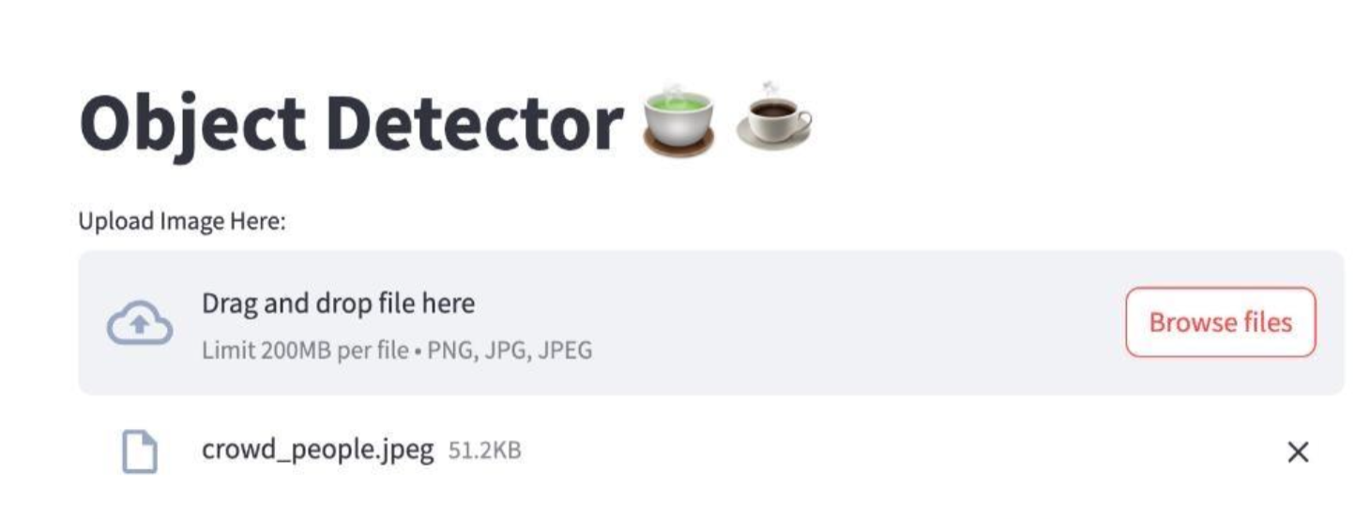
OUR OBJECTIVES
GOALS ?
01
02
03
Created a user-friendly interface for visualizing the real-time video feed and detected objects, enabling easy interaction and analysis
Enhance the efficiency and accuracy of the system by exploring optimization techniques, model customization, and hardware acceleration strategies.
Evaluate the system's performance against established benchmarks and identify areas for further improvement.

Slide 8





TECHNOLOGIES USED
TENSORFLOW
PyTorch
TORCHVISION
PIL
YOLOv5
TensorFlow: TensorFlow is an open-source machine learning framework developed by Google. It provides developers
ML at the cutting edge and developers to easily build and deploy ML-enabled applications
PyTorch: PyTorch is an open-source machine learning library for Python based on Torch for
applications such as natural language processing. It was primarily developed by Facebook's AI research
lab.
Torchvision: a library that provides access to popular datasets, model architectures and image
transformations for computer vision. It is used here to load the pre-trained model and perform image
PIL (Python Imaging Library): A library used to open, process and save various image file
formats. It is used here to load images from the file system.
YOLOv5: is a state-of-the-art object detection model known for its speed and accuracy. It is
designed to be easy to use and customize, making it suitable for a wide range of applications.-

Slide 9
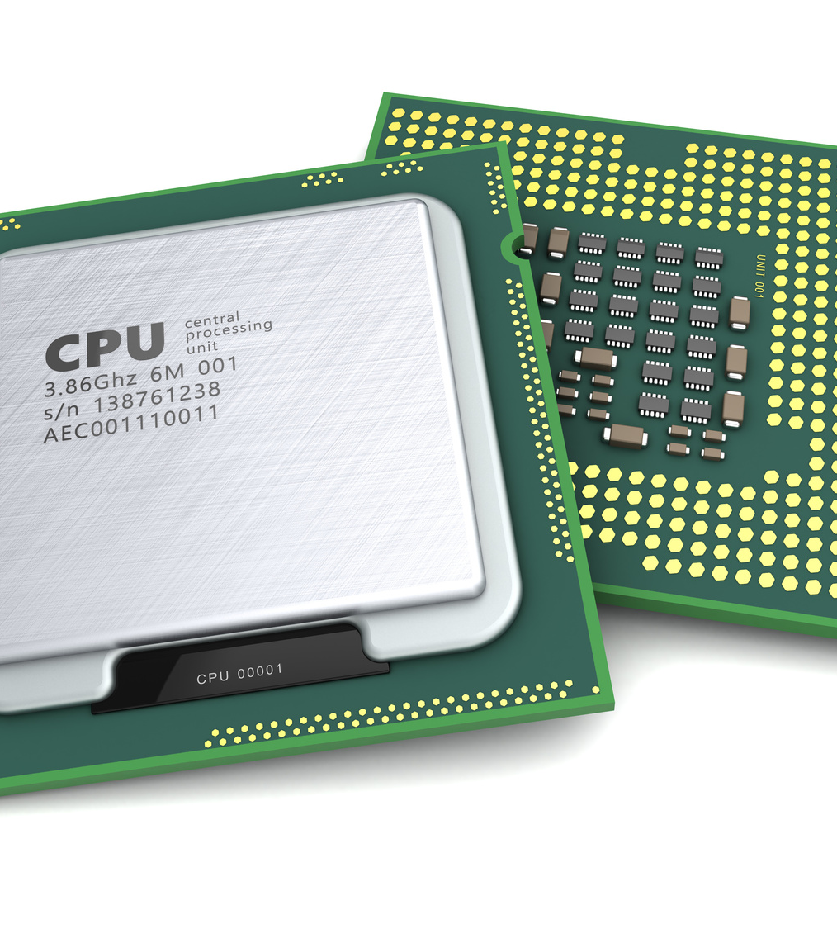
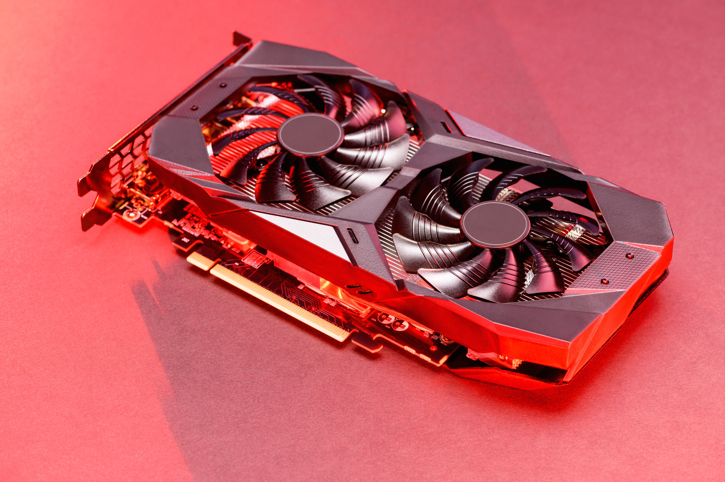
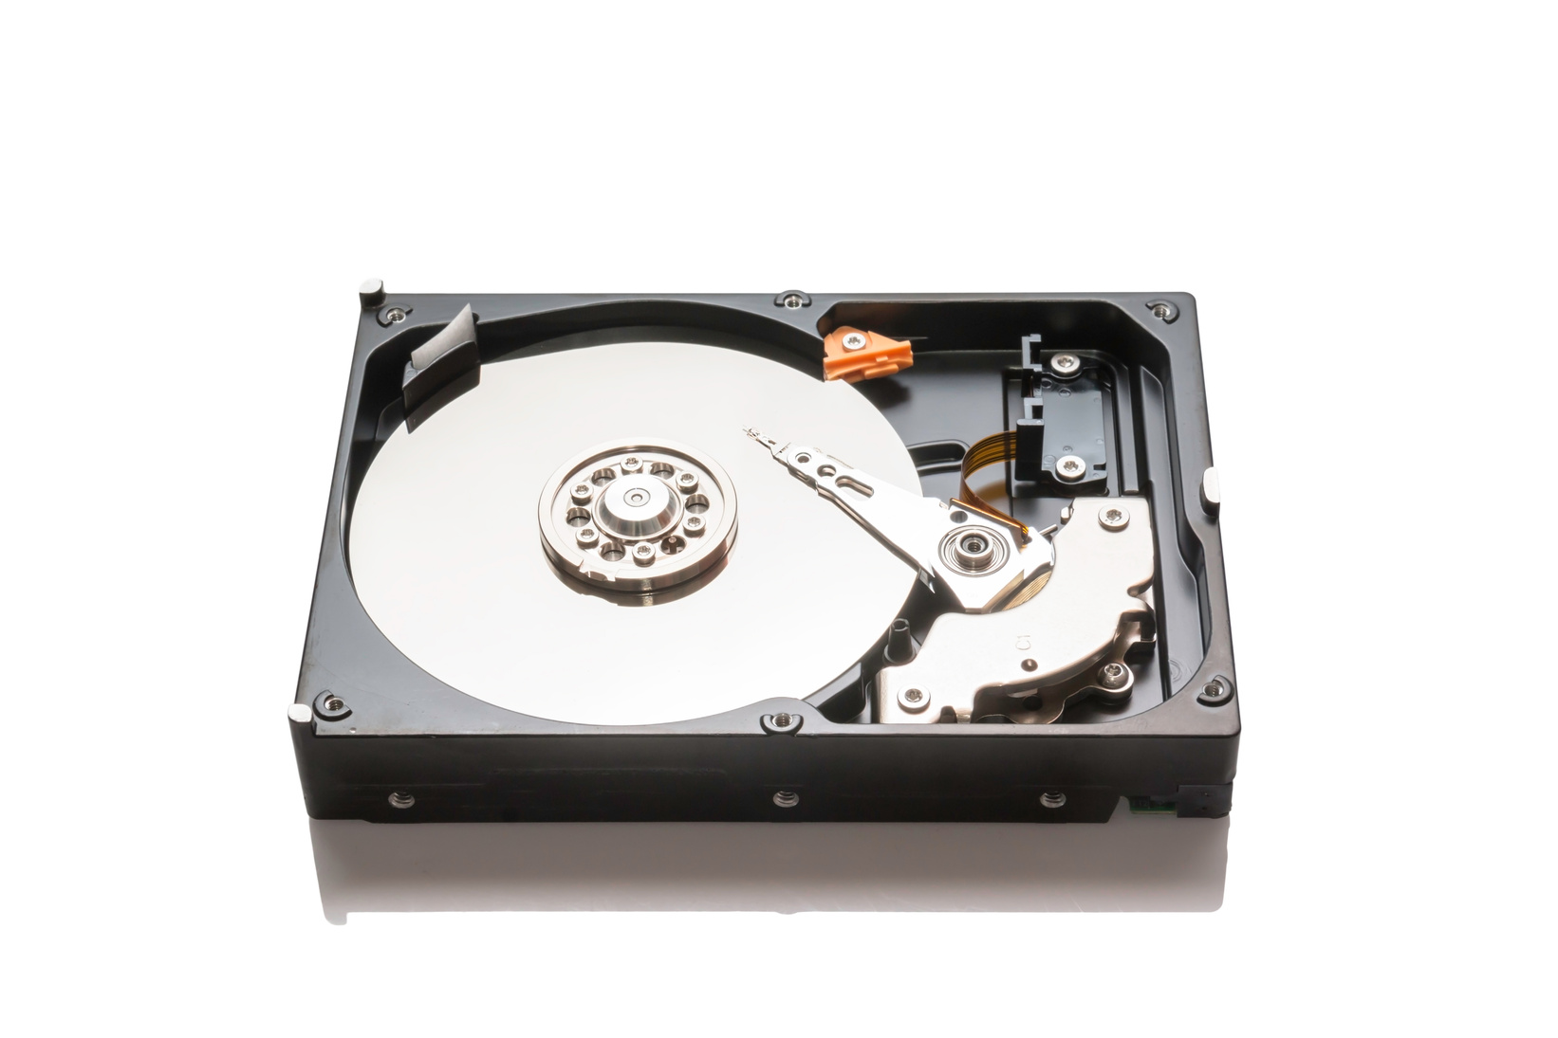
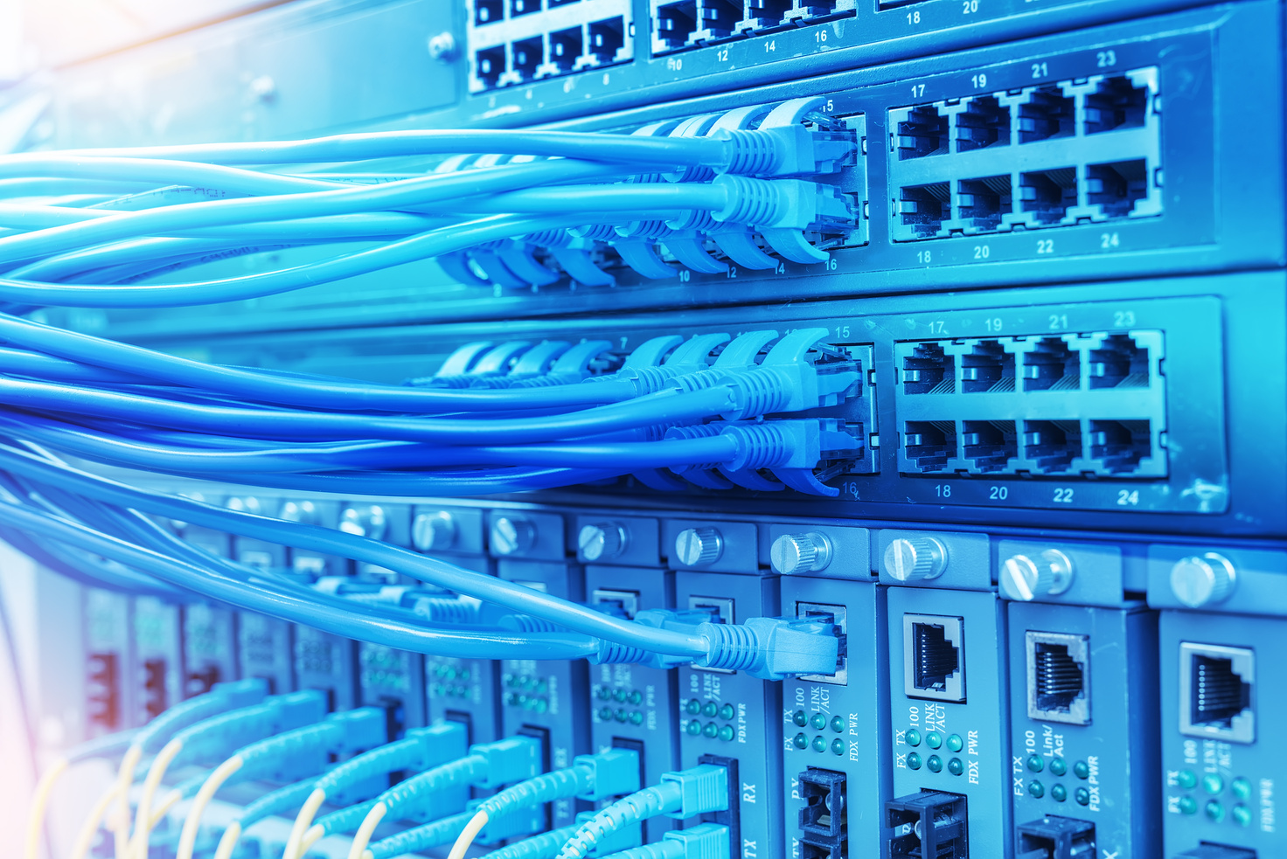
HARDWARE REQUIREMENTS
Processing unit (CPU/GPU) - CPU For systems with limited computing power or where real-time performance is not critical, a modern multi-core processor ( e.g. .Intel Core i5/i7 or AMD Ryzen
5/7) may be sufficient
A dedicated GPU is recommended for real-time object detection, especially for highresolution video streams or complex models. NVIDIA GPUs, such as the GeForce GTX 1080 Ti or higher, are often used because of their CUDA cores,
Hard Disk Space: The amount of storage space required also depends on the size and number of video streams to be processed. At least 1 TB is recommended, and more is better, especially for long-term storage and analysis.
Network- Live processing requires a stable and fast internet connection, especially if the video stream is broadcast over the network. Gigabit Ethernet is recommended for wired connections, while Wi-Fi 5 (802.11ac) or later is suitable for wireless connections.

Slide 10
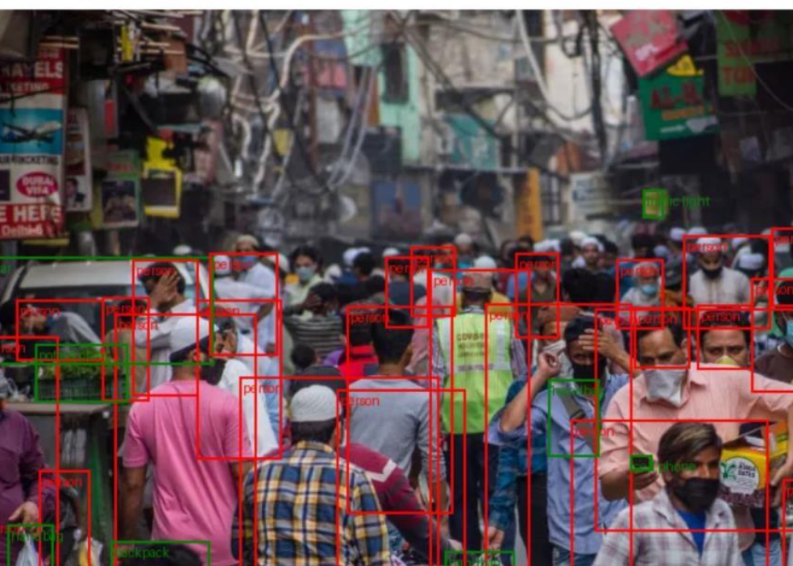
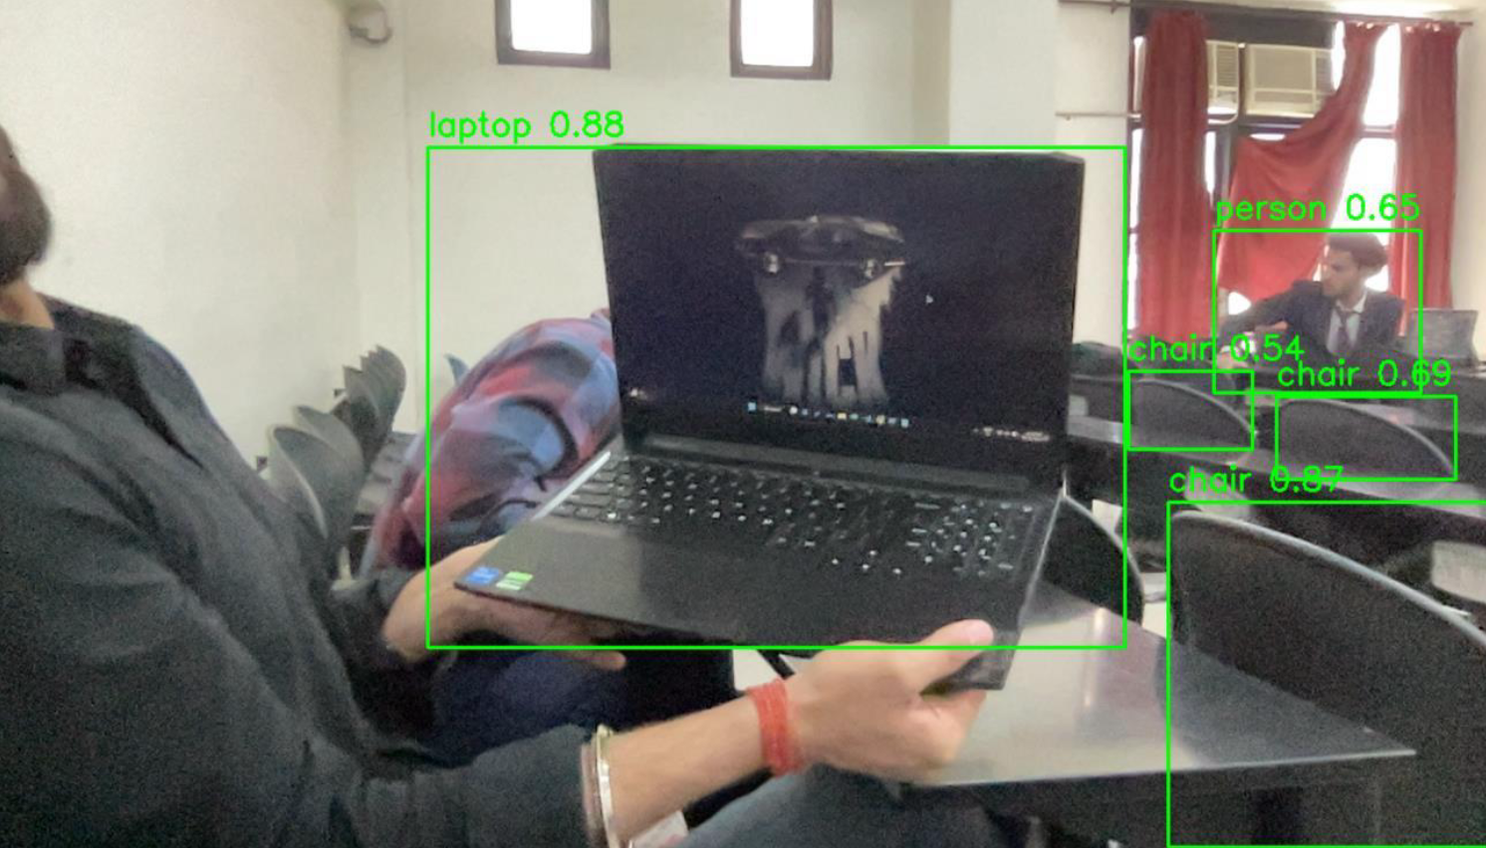
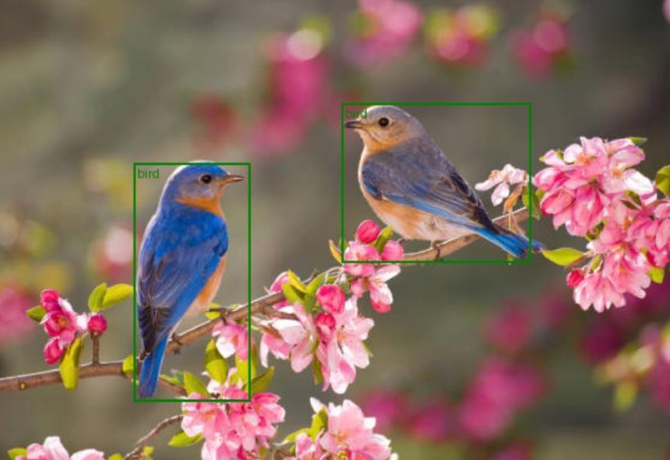
DEMO RESULTS
DEMO IMAGES | ACCURACY | SPEED
CROWD | 78 % | 0.2 ms
LAPTOP | 88 % | 0.1 ms
BIRDS | 96 % | 0.05 ms

Slide 11
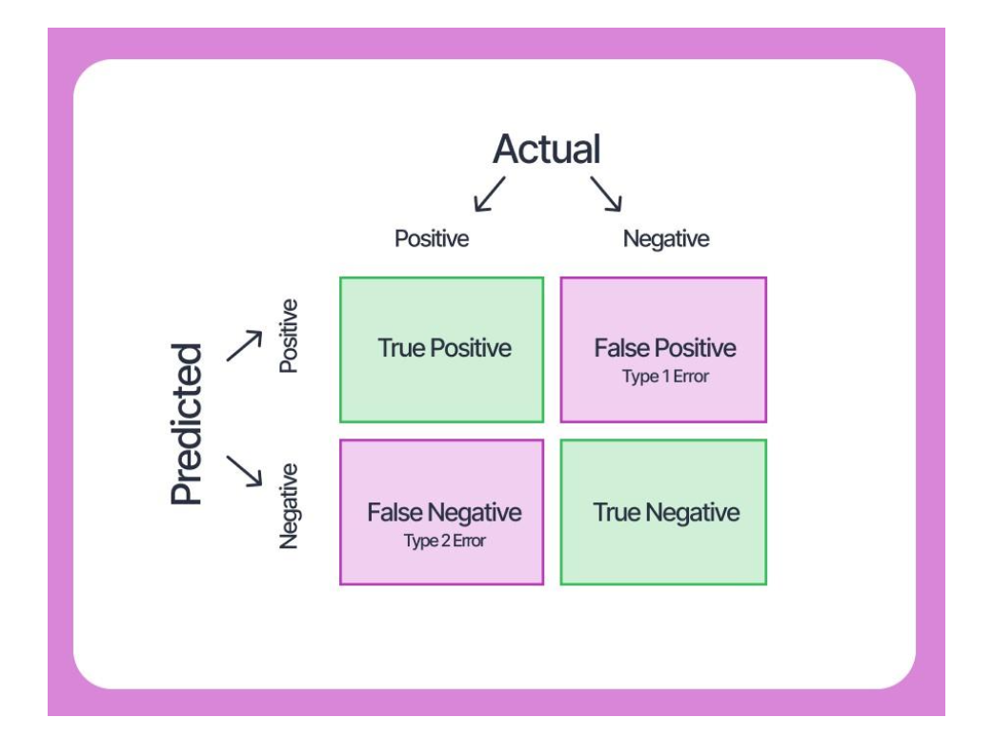
MORE ON ACCURACY
To evaluate the accuracy of an object recognition model, you need to compare the model's predictions with the ground truth labels. Here is a general approach to calculating and reporting model accuracy.
Count true positives, false positives and false negatives.
True Positive (TP): The model correctly identified the target.
False positive (FP): The model detected an object that was not in the ground.
False negative (FN): The model did not detect an object even though it was present in the ground truth.

Slide 12

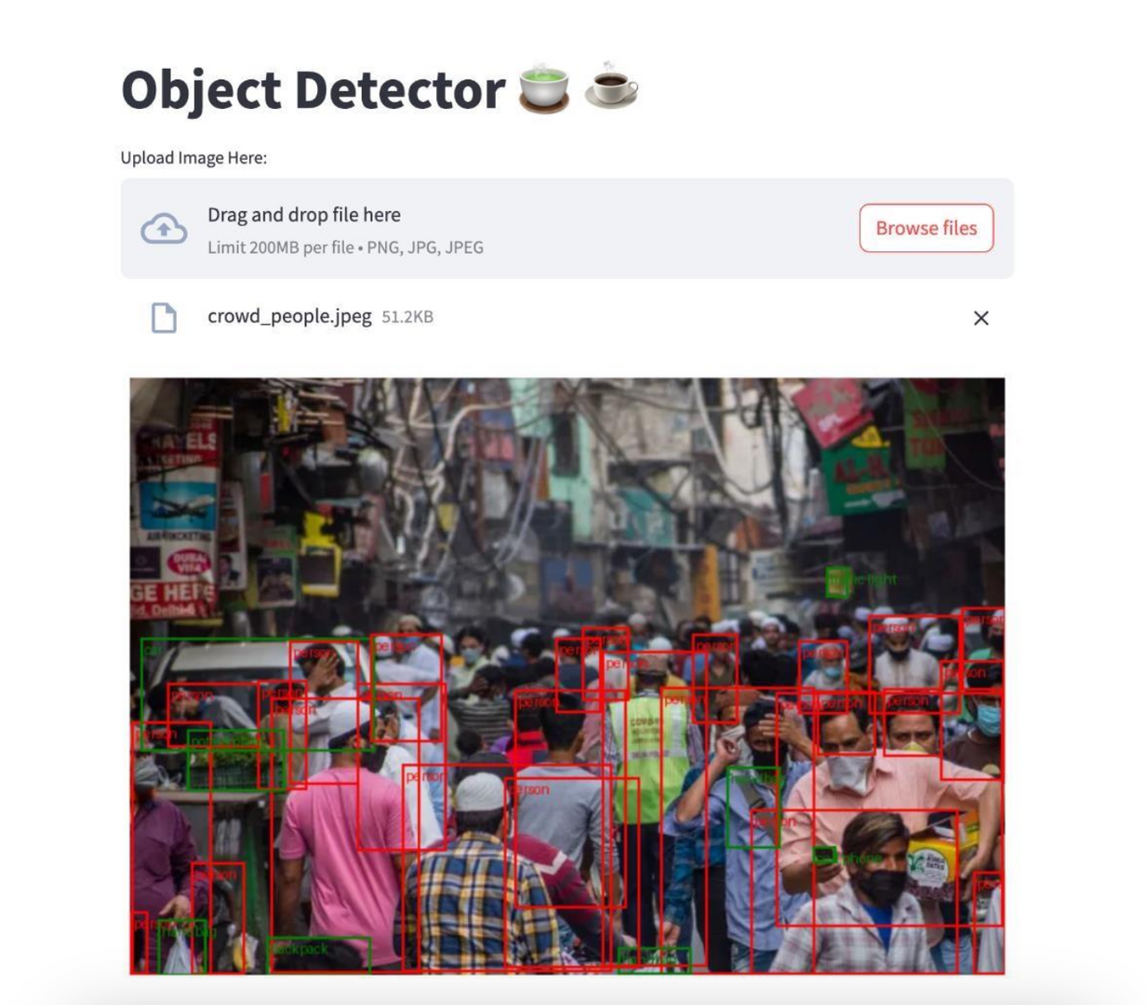
GUI DEMO EXAMPLES
Supports upto 200 MB image files in any format

Slide 13
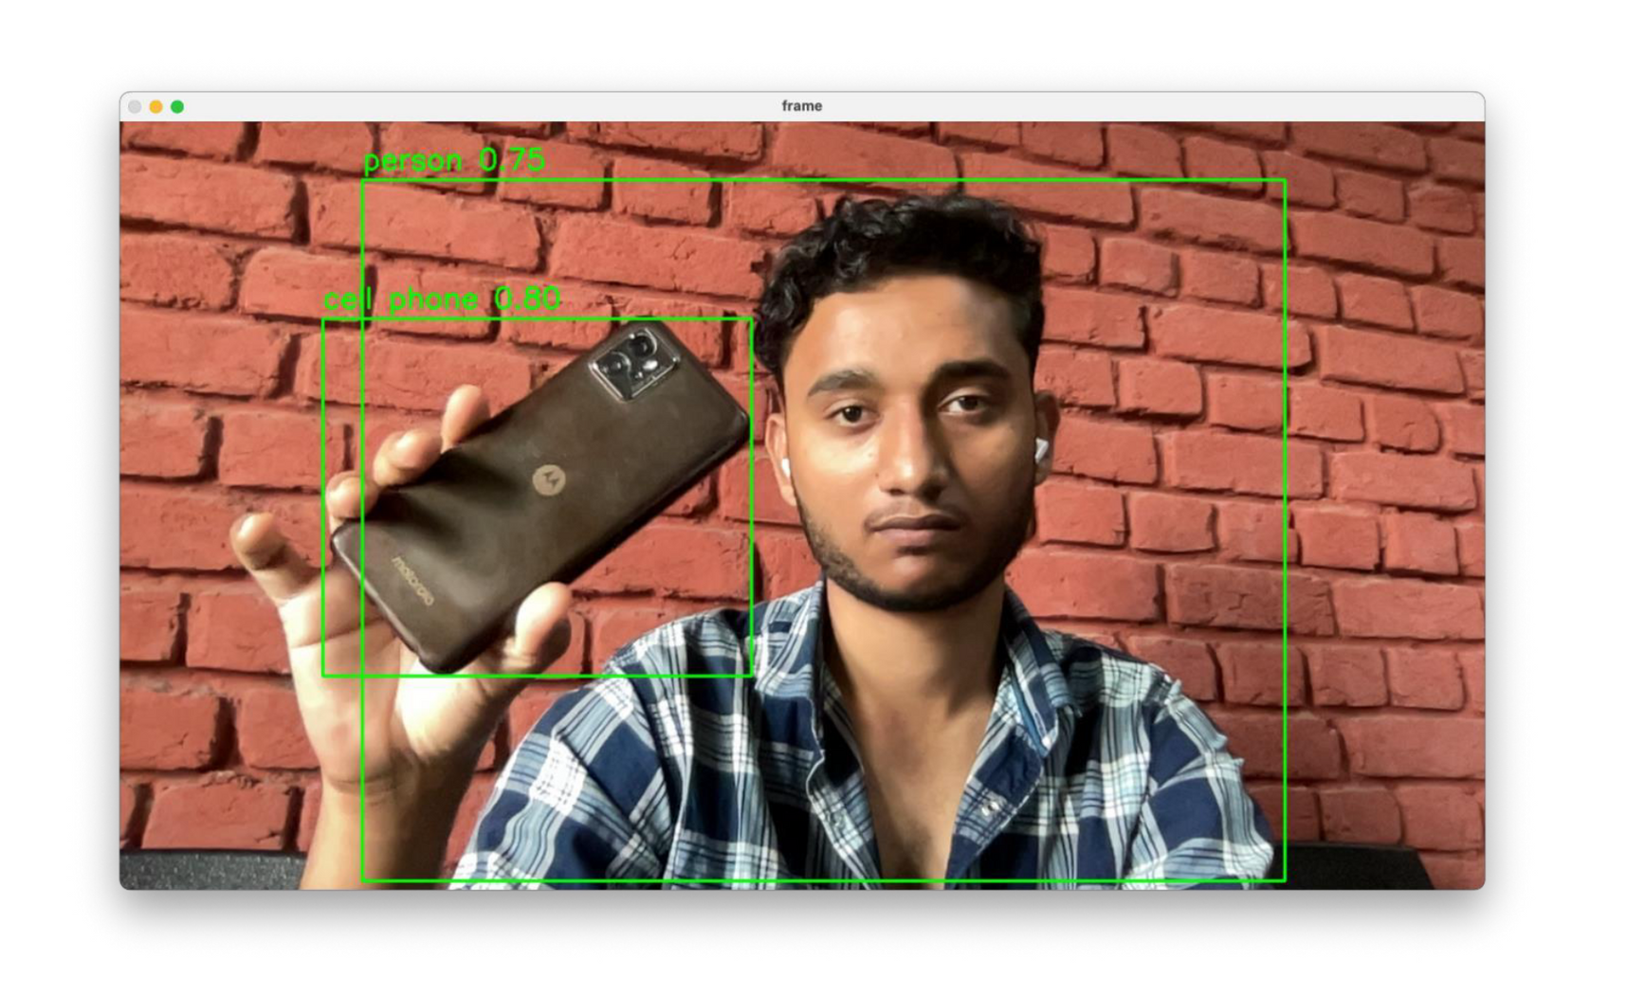
LIVE CAMERA FEED EXAMPLE
Supports image tracking upto 30fps

Slide 14
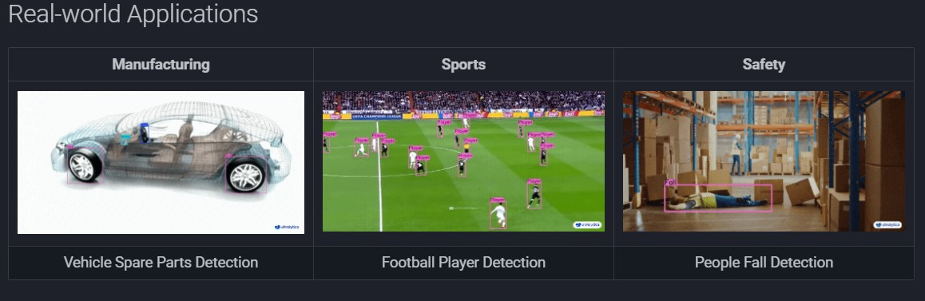
REAL WORLD APPLICATIONS

Slide 15
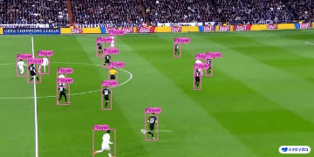
REAL WORLD APPLICATIONS
Football player performance tracking

Slide 16
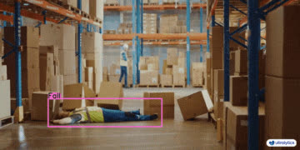
REAL WORLD APPLICATIONS
Unusual Activity
Accident Detection

Slide 17
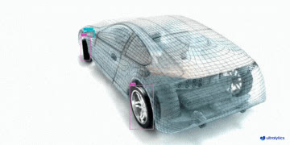
REAL WORLD APPLICATIONS
Manufacturing defect and
proper alignment detection

Slide 18
Thank You.
SUPERVISOR: ASST. PROF. ANCHAL SAGAR
RAUT SHUBHAM
AMAN PAL
VIVEK KUMAR GUPTA
BONTHA CHAKRI
12222170
12221792
12215379
12204429

